Slide 1
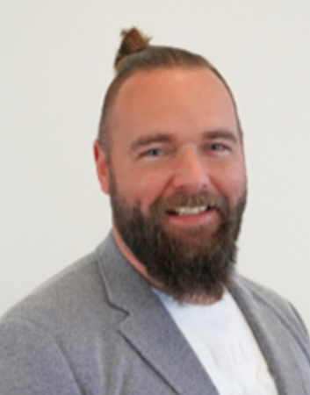
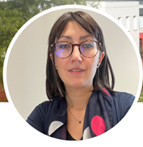
SIG Lean Thinking and Practice: Webinars Organisation 2023
Animated by :
Daryl Powell – Chief Scientist, SINTEF Manufacturing, Norway
Anne Zouggar – Researcher IMS France

Slide 2
Main targets
Topic
Lean Collaboration Projects
Scientific Research Results
Testimonies and industrial feedbacks
Webinars Organisation 2023
Frequency
Quarterly meeting
Duration
45 minutes
5 mins updates, news
20 minutes Talk
20 minutes exchange (questions, feedbacks, testimonies)
Spring Webinar
Summer Webinar
Autumn Webinar
Winter Webinar
Kick off
Coupled – APMS Conference
Audience
SIG members (Lean SIG + others)
PhD Students
Researchers
Practitioners
Target
Maintain dynamic exchange among the members
Support a connected and updated network
Interact with other SIG
Talk contribution to submit
Contact: daryl.powell@sintef.no
anne.zouggar@ims-bordeaux.fr

Slide 3
Spring Webinar
28 APRIL 2023 at 2 p.m
Daryl Powell – Anne Zouggar
Kick off (5 min)
Anne Zouggar –
Digital Lean: Practical overview and current SIG project (20 min)
Questions/Exchanges (20 min)

